Slide 1
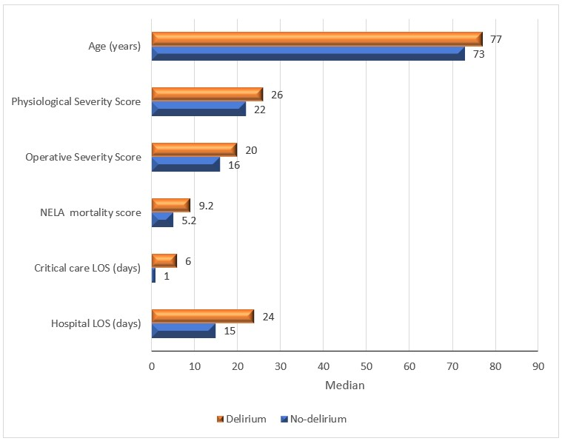
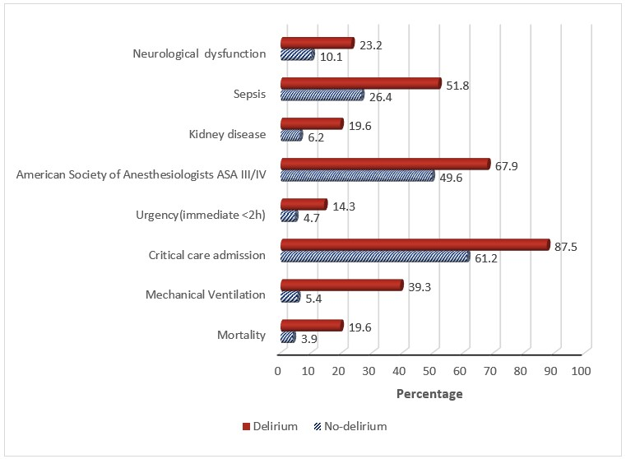
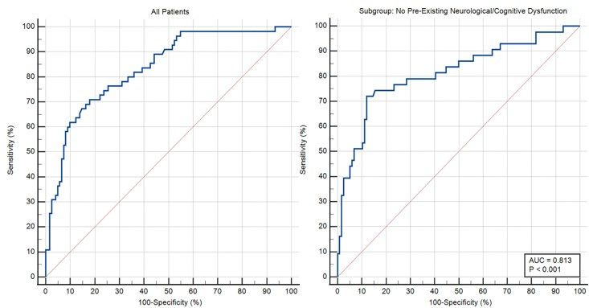
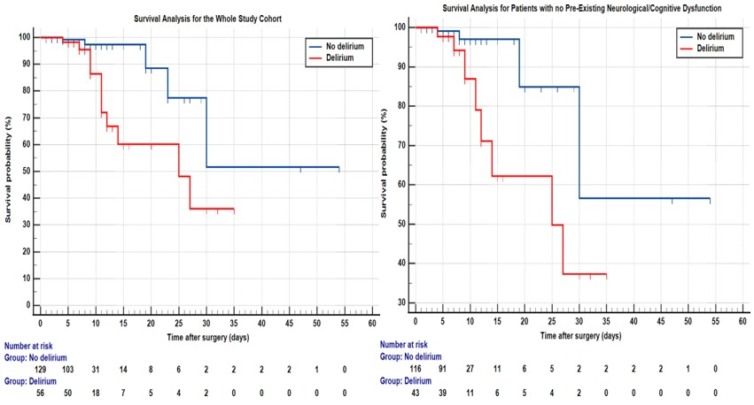
A Study of Postoperative Delirium in Older Adults Undergoing Emergency Surgery
Nada M.Mousa^{a,b}, Ghada A.Hassan^{b}, Abd Alrahman Ahmad^{b}, Sabry Abdallah^{b}, Fang Gao Smithª
a) Institute of Inflammation and Ageing, University of Birmingham, United Kingdom.
b) Department of Anaesthesiology, Intensive Care and Pain Management, Faculty of Medicine, Menoufia University, Egypt
Introduction
Postoperative delirium (POD) is one of the serious complications due to its detrimental economic and social effects and is related to a longer hospital stay and increased mortality¹. The study aimed to investigate the incidence, independent risk factors, and outcomes of POD after emergency laparotomy.
Methods
This observational cohort study aimed to investigate the incidence, the independent perioperative risk factors and the outcomes associated with POD in elderly patients ≥ 65 undergoing emergency laparotomy and registered on the National Emergency Laparotomy Audit (NELA) database at Queen Elizabeth Hospital in Birmingham, UK. Patients were screened for delirium daily for five consecutive days postoperatively using the modified Richmond Agitation Sedation Scale (mRASS) and Confusion Assessment Method for ICU (CAM-ICU)². The final diagnosis of delirium was done using the Diagnostic and Statistical Manual of the American Psychiatric Association (DSM-5). The clinical notes were scanned for keywords using a validated chart abstraction method³. Univariate and multivariate analyses were performed for the entire study population as well as a subgroup of patients without pre-existing neurological or cognitive dysfunction.
Results
The entire study group analysis
Of 185 patients, 56 (30.3%) developed POD.
There was a significant association between POD and ageing, preoperative kidney disease, neurological and sepsis.
Higher American Society of Anaesthesiology ASA and NELA mortality scores, increased operative severity, physiological scores, and urgency of the operation were significantly related to POD.
The incidence of POD was also significantly associated with ICU admission, length of hospital stay, and duration of mechanical ventilation.
The multivariate logistic analysis identified Ageing, female, neurological dysfunction, sepsis, operative severity score, and postoperative mechanical ventilation were independent risk factors for POD.
Subgroup analysis for patients without pre-existing cognitive or neurological dysfunction.
Of 159 patients, 43 patients (27%) developed POD.
Ageing, kidney disease, sepsis, high ASA and physiological severity scores, NELA mortality score, lower serum albumin level, critical care admission and length of stay, mechanical ventilation duration, hospital stay, and mortality rate were significantly associated with POD.
Multivariable logistic analysis revealed ageing, chronic kidney disease, and postoperative mechanical ventilation as independent risk factors for POD.
Figure(1) shows the perioperative predisposing and precipitating risk factors and the outcomes of Postoperative delirium in the whole study population.
A)
B)
A)
B)
Whole study population
Variables | OR (CI) | P-value
Age | 1.069 (1.009 to 1.132) | 0.023*
Female | 3.380 (1.464 to 7.803) | 0.004*
Preexistent neurological/cognitive dysfunction | 3.773 (1.322 to 10.773) | 0.013*
Frailty | 2.364 (1.002 to 5.573) | 0.049
Sepsis | 2.743 (1.134 to 6.630) | 0.025*
Operative severity score | 1.102 (1.016 to 1.195) | 0.020*
Mechanical Ventilation | 7.959 (2.788 to 22.726) | <0.001*
Subgroup population
Variables | OR (CI) | P-value
Age | 1.075 (1.011 to 1.142) | 0.020*
Female | 2.322 (0.9617 to 5.614) | 0.061
Kidney disease | 4.757 (1.457 to 15.528) | 0.010*
Albumin (g/l) | 0.936 (0.884 to 0.992) | 0.025*
Mechanical Ventilation | 10.338 (3.569 to 29.950) | <0.0001*
Figure (2)
A) Receiver-ope0rating characteristic (ROC) curve from logistic regression model for prediction of delirium in the whole study population. The model has a good predictive value with an area under the ROC curve (AUC) of 0.835. A cut-off predicted probability > 0.33 has a sensitivity of 71% and specificity of 82% (J-index = 0.53).
B) ROC curve from the logistic regression model for the prediction of delirium in patients without pre-existing neurological/cognitive dysfunction. The model has a good predictive value with an area under the ROC curve (AUC) of 0.813. A cut-off predicted probability > 0.29 has a sensitivity of 72% and specificity of 88% (J-index = 0.60).
Figure (3)
A) Kaplan-Meier survival curves for patients with or without delirium in the whole study cohort. Markers across lines represent censored data. The difference between both curves is statistically significant (Logrank chi-squared = 7.319, DF = 1, p-value = .0008). Hazard ratio = 4.14, 95% CI = 1.48 to 11.59.
B) Kaplan-Meier survival curves for patients with or without delirium and no pre-existing neurological/cognitive Dysfunction. Markers across lines represent censored data. The difference between both curves is statistically significant (Logrank chi-squared = 5.399, DF = 1, p-value = .020). Hazard ratio = 4.18, 95% CI = 1.25 to 13.99.
Conclusion
POD is a common complication after emergency laparotomy surgery in the elderly, with longer hospital stays and high mortality rates. Ageing, preoperative sepsis, kidney and neurological diseases are independent risk factors. Proper identification of risk factors underscores the need for tailored interventions and management strategies to reduce the incidence and consequences of POD in older patients.
Funding and Acknowledgments
The authors are grateful for the funding provided by the Egyptian mission sector of the Ministry of Higher Education in Egypt. Additionally, we would like to express our appreciation to Assistant Prof. Thomas Jackson and Prof. Tonny Veenith for their invaluable support and guidance during this project, and to Prof. Sameh Michel for his assistance with the statistical analysis.
Reference
Ida M, Takeshita Y, Kawaguchi M. Preoperative serum biomarkers in the prediction of postoperative delirium following abdominal surgery. Geriatr Gerontol Int [Internet] 2020; 20: 1208–12 Available from: http://onlinelibrary.wiley.com/doi/abs/10.1111/ggi.14066
Chen T-J, Chung Y-W, Chang H-C (Rita), et al. Diagnostic accuracy of the CAM-ICU and ICDSC in detecting intensive care unit delirium: A bivariate meta-analysis. Int J Nurs Stud [Internet] 2021; 113: 103782 Available from: https://www.sciencedirect.com/science/article/pii/S0020748920302686
Krewulak KD, Hiploylee C, Ely EW, Stelfox HT, Inouye SK, Fiest KM. Adaptation and Validation of a Chart-Based Delirium Detection Tool for the ICU (CHART-DEL-ICU). J Am Geriatr Soc [Internet] 2021; 69: 1027–34 Available from: http://onlinelibrary.wiley.com/doi/abs/10.1111/jgs.16987
Table (1) Multivariate analysis of the perioperative risk factors associated with postoperative delirium in the whole group and subgroup populations.
*P-value of < 0.025 statistically significant.

